Slide 1
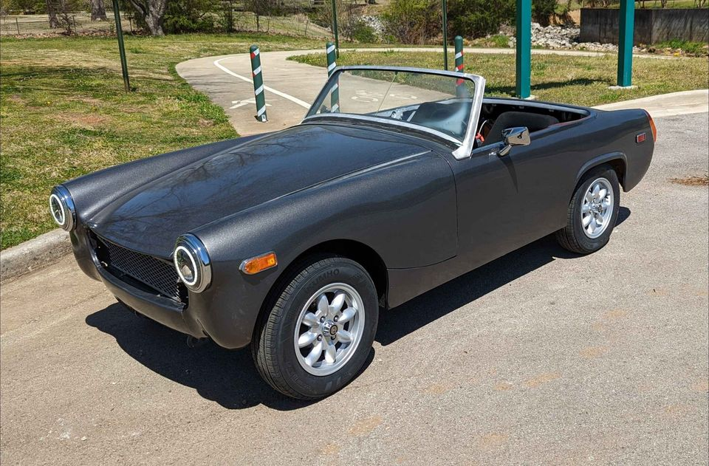
ENGINEERING FORENSICS & MODERNIZATION BLUEPRINT
1970s MG Midget EV Modernization
Forensic Hardware Registry, Safety Remediation & AI-Defined EV (AIDC) Architecture
• Chassis: MG Midget MkIII / 1500 (Anthracite Grey Metallic)
• Current Powertrain: Advanced D.C. Motors (ADC) Series-DC + Curtis PMC 1221B/1231C
• Battery: 3x Chevrolet Volt Hybrid (LG Chem 16S NMC, ~96V-116V, 16 kWh)
• Primary Finding: CRITICAL SAFETY GAP — Zero Active BMS on High-Density Lithium Pack
• Proposed Transformation: Software-Defined EV with Teensy 4.1 VCU + Hailo-8 Edge AI (26 TOPS)
CONFIDENTIAL BRIEFING | OCTOBER 2026 | PREPARED FOR EXECUTIVE ENGINEERING REVIEW

Slide 2
EXECUTIVE SUMMARY
From Analog Restomod to AI-Defined Roadster
Strategic evaluation of the current conversion, safety vulnerabilities, and modernization roadmap.
1. As-Built Status (The Foundation)
• Chassis: Agile, lightweight 1970s British roadster (~1,850 lbs curb weight).
• Powertrain: Reliable 8/9" ADC Series-Wound DC motor coupled to 4-speed manual gearbox.
• Energy: ~16 kWh LG Chem NMC pack providing 60-80 miles potential range.
• Limitation: Rigid analog PWM control, zero telematics, and crude voltage monitoring.
2. Critical Vulnerabilities (The Hazards)
• Unmonitored Pack: 48 lithium cells operating without a Battery Management System (BMS).
• Thermal & Runaway Risk: Over-charge or deep discharge can cause violent cell failure.
• Loose Engine Bay Wiring: Bare uninsulated 12V wire ends dangling near fuse block.
• Physical Security: Battery pack held in trunk solely with a yellow ratchet strap.
3. The AI Transformation (The Vision)
• Safety Core: Orion BMS 2 + Isabellenhütte IVT-S current shunt + Teensy 4.1 VCU.
• Edge AI Perception: Raspberry Pi 5 + Hailo-8 NPU (26 TOPS) for vision ADAS & range prediction.
• Stealth Cockpit: Circular 800x800 display embedded behind original Smiths chrome bezel.
• Voice Copilot: Multimodal Gemini AI providing conversational telemetry and navigation.
KEY PLATFORM METRICS: 96V–116V Nominal Bus | 16.0 kWh LG Chem Pack | 26 TOPS Hailo-8 NPU | $2,314.50 Complete AI BOM

Slide 3
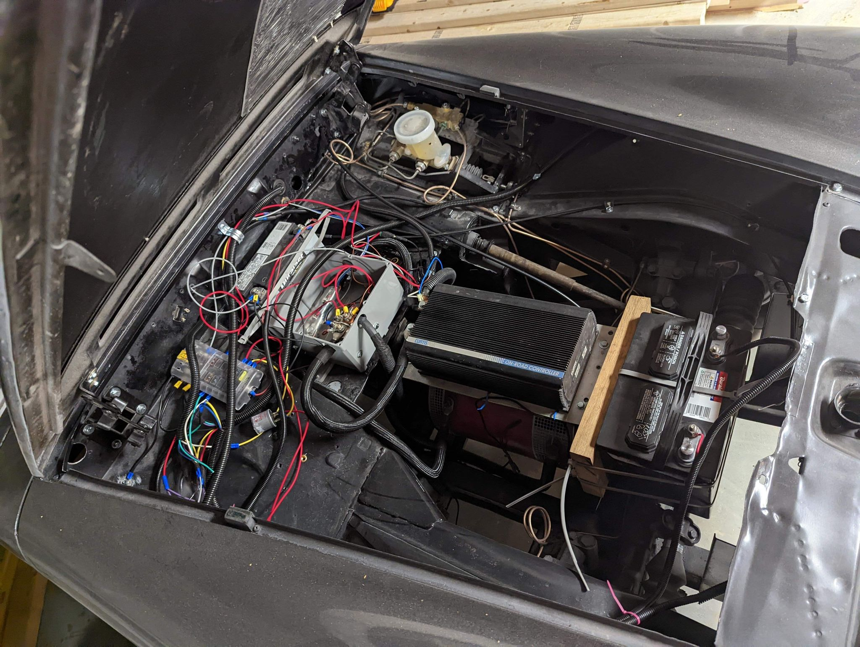
VEHICLE PROFILE & PACKAGING
Vehicle Forensic Audit & Component Packaging
Chassis identification, mechanical dimensions, and physical distribution of high/low voltage systems.
Chassis & Exterior Styling
• Identification: 1974–1979 MG Midget MkIII / 1500 roadster with round rear wheel arches.
• Aesthetic Details: Anthracite metallic grey bodywork with dual white rally stripes.
• Lighting & Wheels: 7" Halo LED projector headlights; 13" classic Minilite-style alloy wheels.
Powertrain & Front Bay Distribution
• Traction Motor: Front bay, mounted low into transmission tunnel using custom aluminum adapter plate.
• Electronics Shelf: Curtis 1221B/1231C controller and Albright contactor box mounted on passenger firewall.
• Auxiliary 12V: Duralast AGM battery and Blue Sea 12-circuit fuse block on front passenger fender ledge.
Rear Boot & Drivetrain Dynamics
• Battery Enclosure: 3x LG Chem 16S modules placed in trunk floor; Elcon 1.5–2kW charger adjacent.
• Transmission: Original British Leyland 4-speed manual gearbox retained with functional mechanical clutch.
• Weight Distribution: ~50:50 front-to-rear weight bias; low center of gravity enhances classic kart handling.

Slide 4
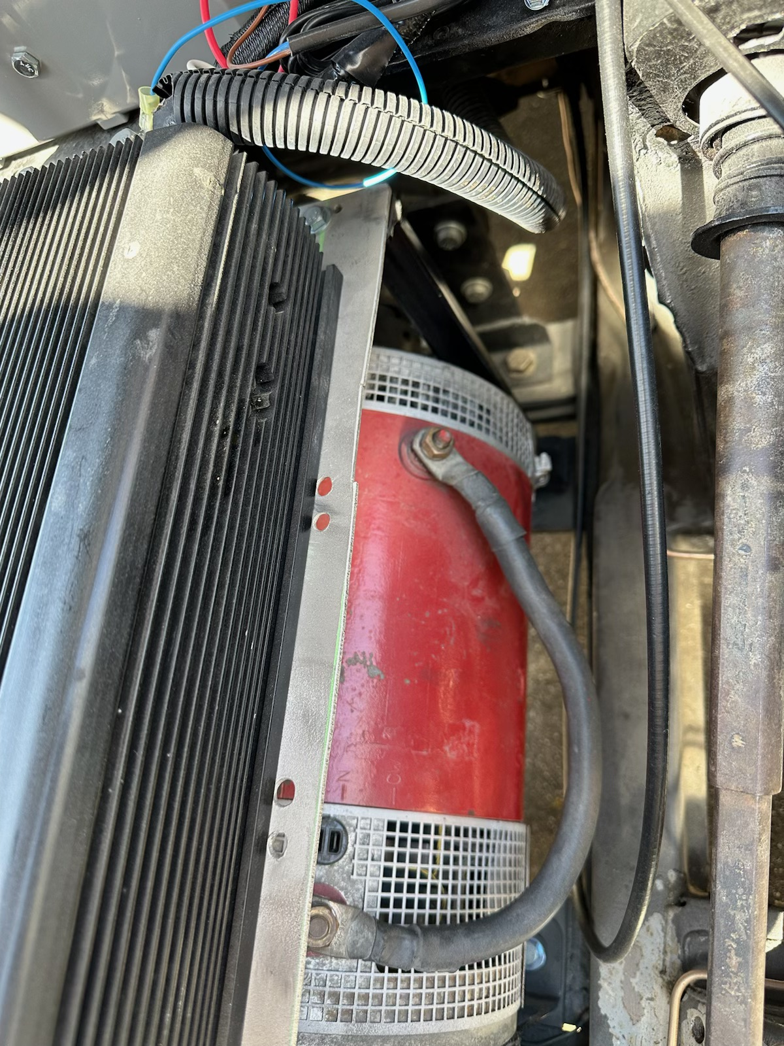
POWERTRAIN FORENSICS
Traction Motor & Motor Controller Architecture
Analysis of the Series-Wound DC traction motor and analog Curtis PMC MOSFET controller.
Traction Motor: Advanced D.C. Motors (ADC)
• Motor Model: ADC Series-Wound DC Motor (FB1-4001A / L91 series), 8" or 9" cast frame.
• Performance Specs: ~20–30 kW peak power (27–40 hp equivalent, >110 lb-ft instantaneous torque).
• Characteristics: Air-cooled with internal fan; terminal lugs marked with '-CW' and '-N' rotation.
• Limitations: Commutator brushes require wear inspection; zero regenerative braking capability.
Motor Controller: Curtis PMC On-Road Series
• Model Identification: Curtis PMC 1221B / 1231C high-frequency MOSFET DC motor controller.
• Voltage & Current: 72V–120V / 96V–144V operational range; 400A–500A peak armature current.
• Control Interface: 2-wire 0–5kΩ resistive throttle input (cable-driven potentiometer box).
• Architecture: Pure analog PWM duty cycle switching; no digital bus, no telemetry broadcast.
Mechanical Drivetrain Coupling
• Transmission Adapter: CNC-machined 0.5" aluminum adapter plate mates motor face to bellhousing.
• Clutch System: Standard clutch disc and pressure plate retained on custom motor taper-lock hub.
• Operational Flexibility: Capable of clutchless starting in 2nd/3rd gear, or traditional manual shifting.

Slide 5
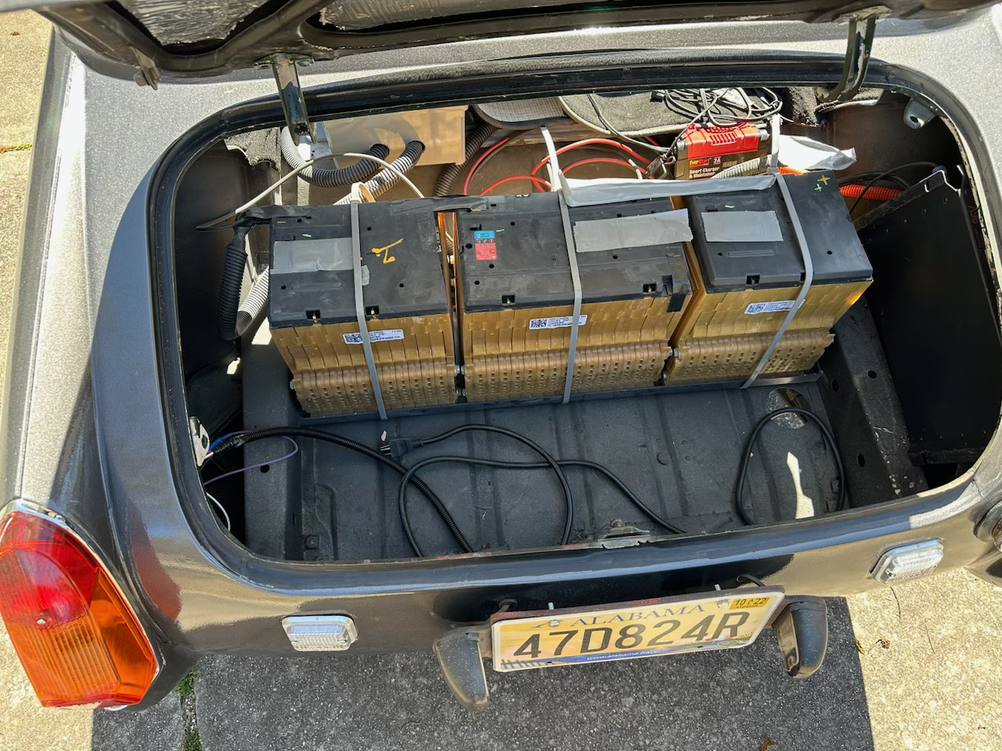
CRITICAL SAFETY AUDIT
High-Voltage Battery Pack: Critical Safety Deficiencies
Forensic inspection of the 3x Chevrolet Volt LG Chem NMC modules and absent management systems.
CRITICAL HAZARD: 48S LITHIUM-ION PACK (NMC) OPERATING WITH ZERO BMS OR THERMAL SENSING
Battery Module Identification
• OEM Source: 3x Chevrolet Volt (Gen 1 / GM OEM) / LG Chem 16S Lithium-Ion NMC modules.
• Cell Chemistry & Energy: High energy density NMC chemistry; ~16 kWh total storage capacity.
• Topology: 48 series cells (48S); ~96V-116V nominal tapped DC bus (177V max if fully seriesed).
Severe Safety Deficiencies & Thermal Risk
• Disconnected Cell Taps: OEM multi-pin voltage tap connectors on top of all modules are unplugged.
• No Over/Under Voltage Cutoff: Single-cell overcharge during charging can trigger thermal runaway.
• Zero Thermal Sensing: No temperature monitoring across high-discharge pouch cells.
• No Isolation Interlock: Contactor does not trip if pack ground fault or cell venting occurs.
Structural Mounting Deficiencies
• Inadequate Restraint: Battery modules sit bare in the trunk secured only by a yellow steel ratchet strap.
• Containment Void: Lacks rigid, sealed, fire-rated, non-conductive steel/aluminum box.
• Venting: No ducted vapor release tube through trunk floor to exhaust combustible gases.

Slide 6
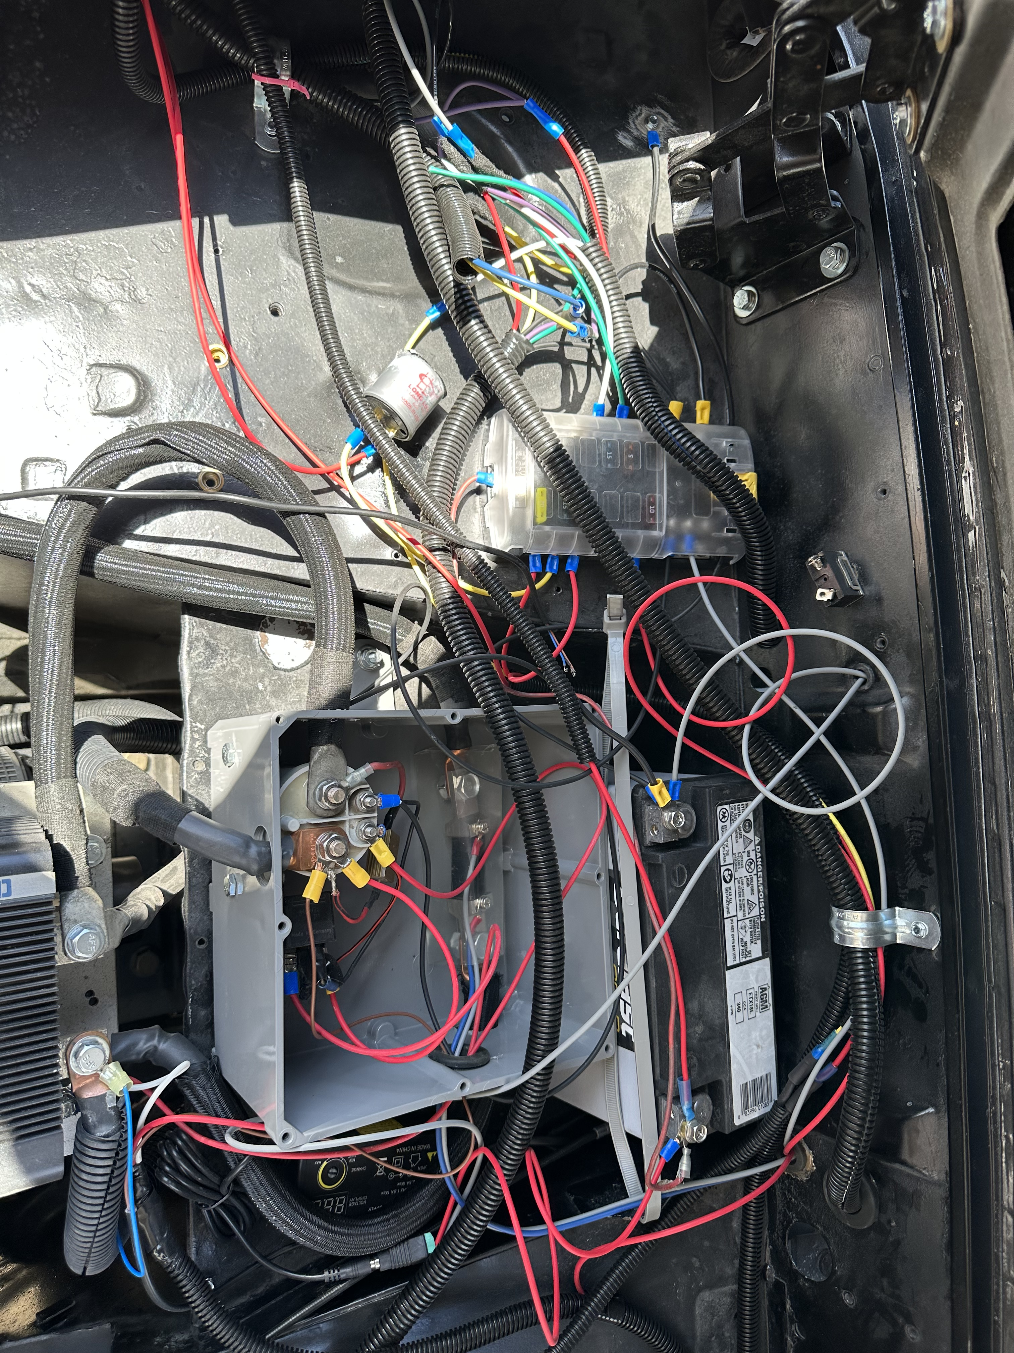
ELECTRICAL ARCHITECTURE
12V Auxiliary System & Fuse Registry
Audit of 12V battery, Blue Sea fuse block, flasher relay, and engine bay wiring integrity.
12V Power & Fuse Distribution Block
• Auxiliary Battery: Duralast ETX18L AGM PowerSports battery (340 CCA, 18 Ah capacity).
• Fuse Block: Blue Sea Systems 5025/5026 12-circuit ST-Blade Fuse Block with negative ground bus.
• Flasher Unit: Long Life thermal turn-signal flasher relay mounted adjacent to the block.
Fuse Population & Circuit Map
• Circuit 1 (10A Red): Keyed Ignition Switch & Contactor Coil Enable.
• Circuit 2 (5A Tan): Instrument Cluster Illumination, Voltmeter & LED Accents.
• Circuit 3 (15A Blue): Horn, Exterior Turn Signals & 12V Dash Power Sockets.
• Circuit 4 (20A Yellow): DC-DC Converter Auxiliary Feed & Pre-Charge Interlock Relay.
• Circuits 5–12: Unpopulated spare circuits (available for VCU, Edge AI & Vision sensors).
Wiring Integrity & Hazards
• Bare Wire Alert: Exposed, uninsulated wire ends dangling loosely above the fuse block (Quadrant 1).
• Chassis Short Risk: Dangling hot wires could contact steel body panels, causing fire or blown main fuse.
• Remediation: Terminate or heat-shrink loose conductors; install protective fuse block cover.

Slide 7
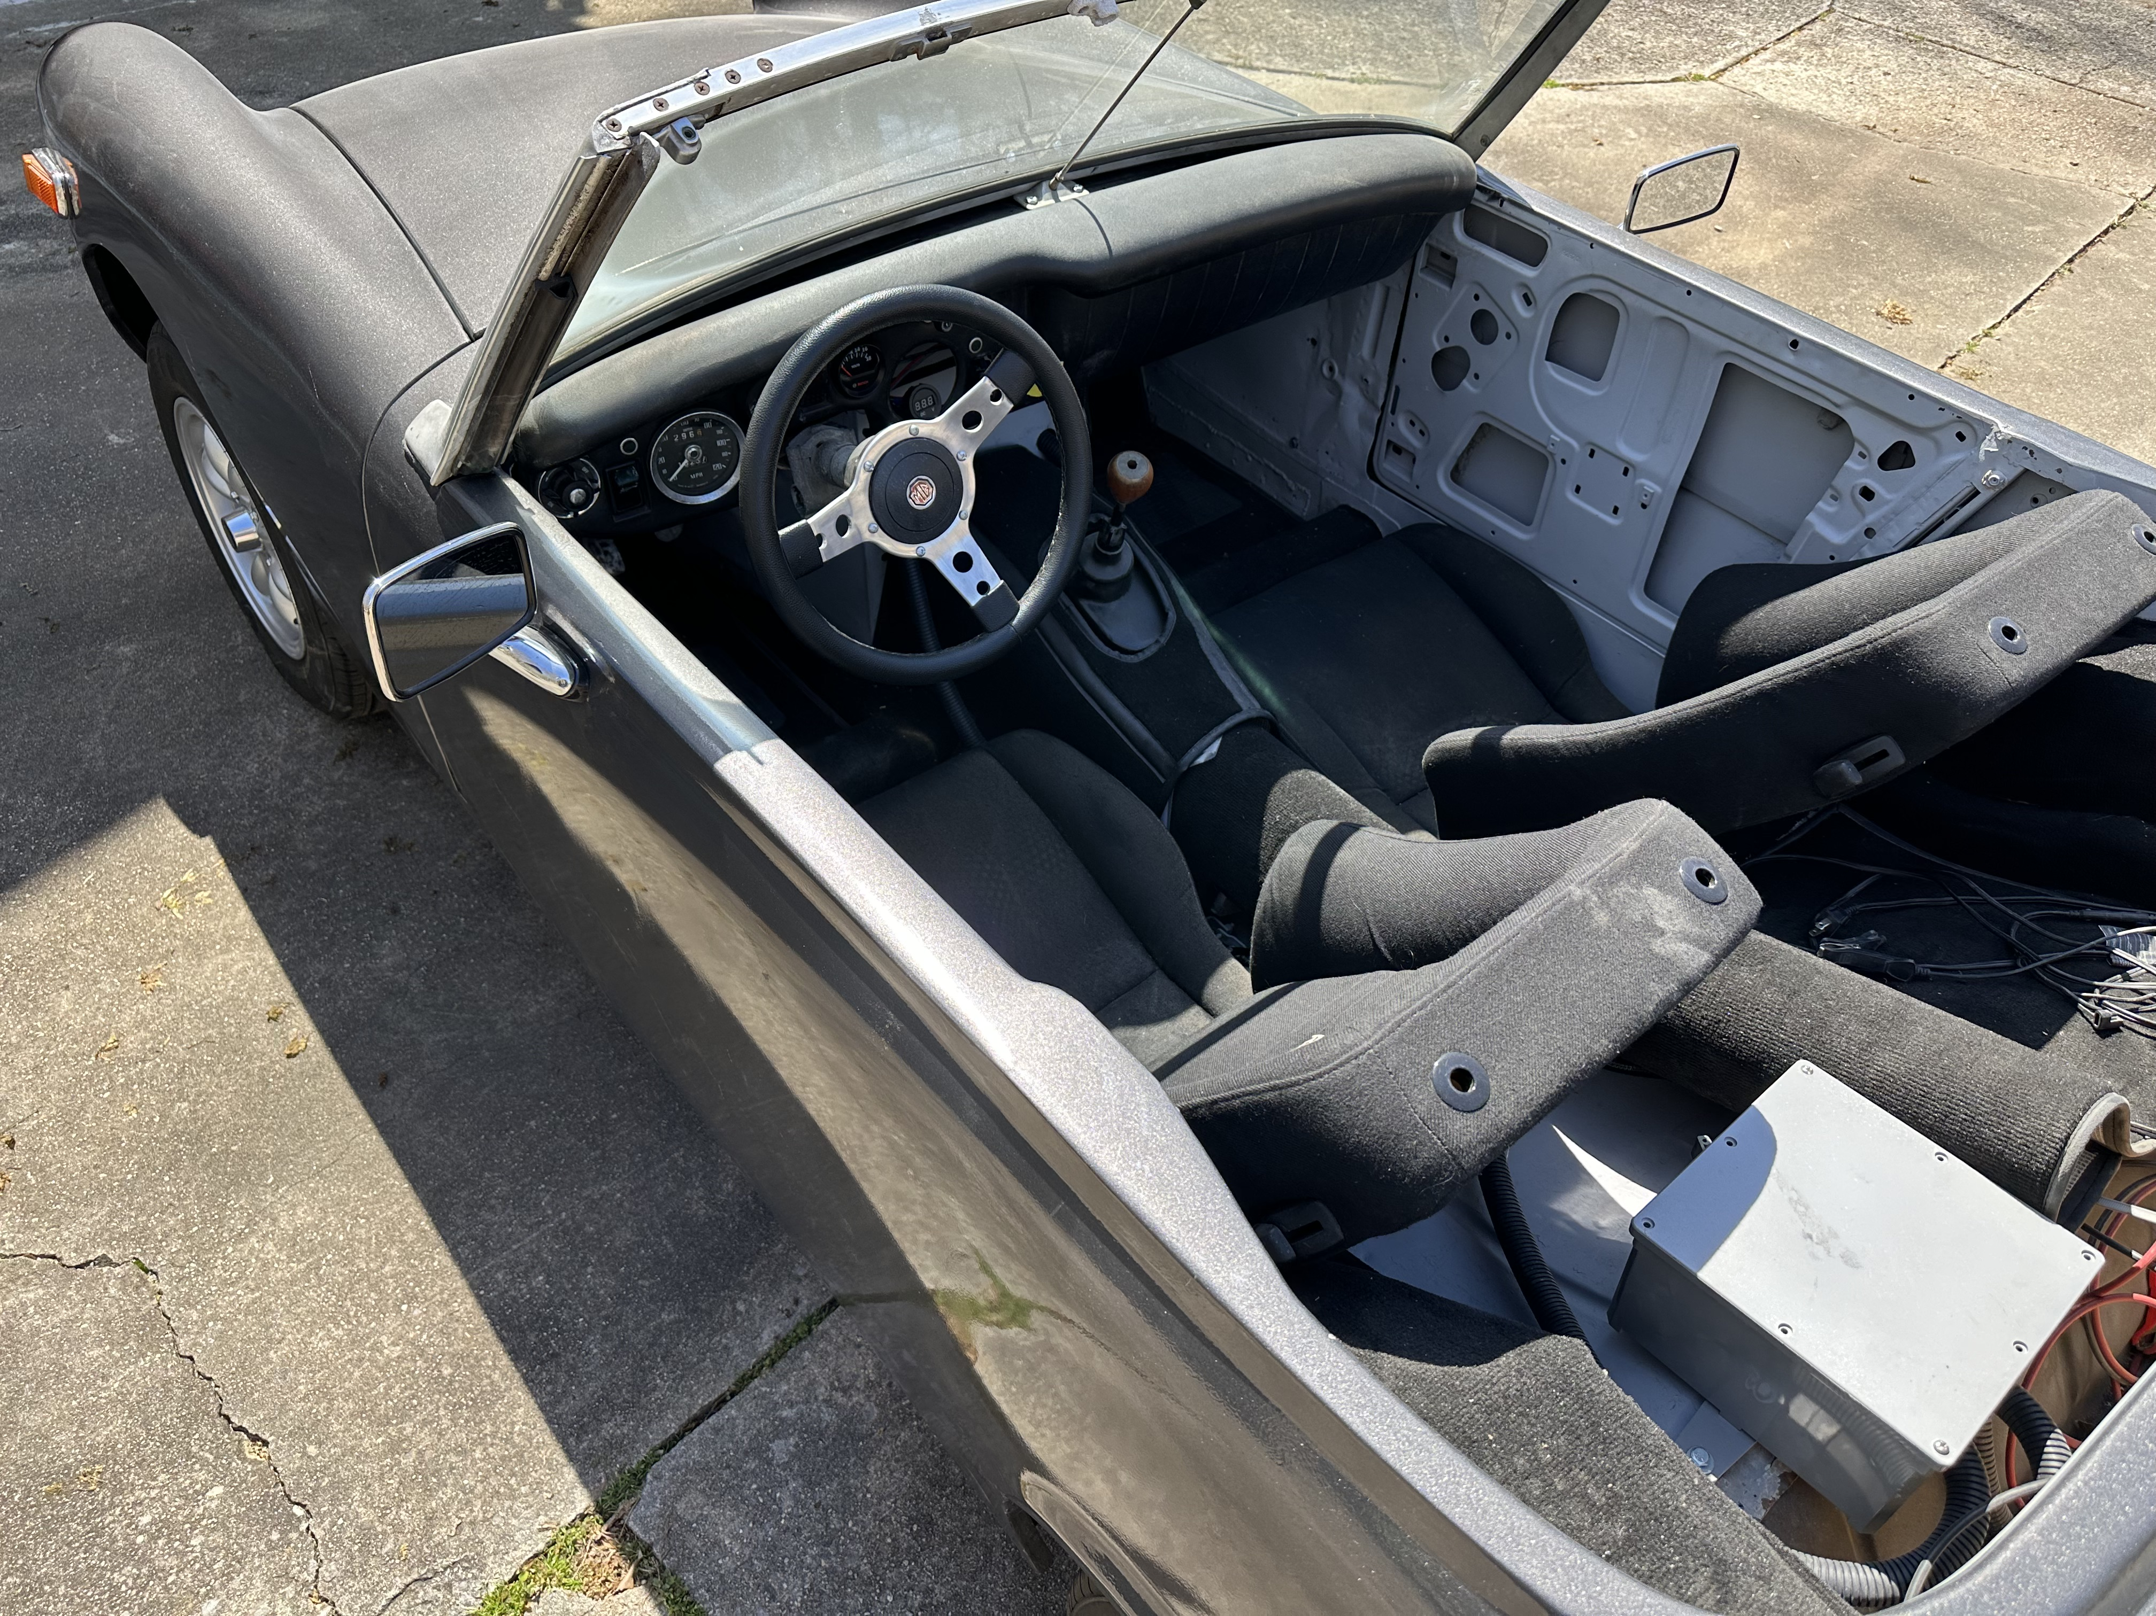
HIGH-VOLTAGE CONTROLS
High-Voltage Junction Box & Contactor Switching
Main traction contactor, pre-charge resistor sequencing, and high-voltage circuit protection.
Main Traction Contactor: Albright SW180 / SW200
• Contactor Specs: Single-pole single-throw (SPST) normally-open industrial DC contactor.
• Electrical Rating: 200A continuous, 1000A peak breaking capacity, 12V DC coil.
• Arc Suppression: Magnetic blowouts integrated into contact chamber to extinguish DC breaking arcs.
• Safety Role: Provides galvanic isolation between battery positive and motor controller when de-energized.
Pre-Charge Resistor & Timing Relay
• Resistor Component: Dale / Vishay RH-50 or RH-100 wirewound aluminum-housed power resistor.
• Rating: 50W–100W, ~500Ω–1000Ω, mounted directly across main contactor terminals.
• Sequencing Relay: Automotive 12V 30A SPDT relay charges Curtis input capacitors prior to main close.
• Engineering Criticality: Prevents severe contactor tip welding and capacitor inrush explosions.
Traction Fuse: Bussmann ANN-300 / ANN-400
• Fuse Specifications: Very fast-acting DC limiter fuse rated for 80V–125V DC, 300A–400A interrupt.
• Mounting: Direct bolted inline to primary battery positive busbar.
• Assessment: Correctly sized for Curtis peak current draw, but lacks automated blown-fuse telemetry.

Slide 8
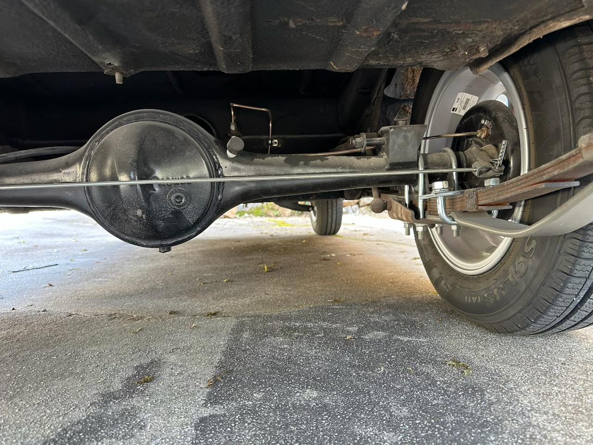
DRIVER ERGONOMICS & HMI
Cockpit Controls & Instrumentation Audit
Evaluation of the driver interface, analog gauge cluster, and critical information gaps.
Instrumentation Hardware
• Primary Speedometer: Original Smiths 0–120 MPH mechanical cable-driven speedometer gauge.
• Auxiliary Voltmeter: Aftermarket 3-digit blue 7-segment LED panel meter ('8.8.8 DC V') on center dash.
• Accessory Power: Dual USB charging port (5V 2.1A) with blue LED halo illumination.
Driver Controls & Shifter
• Transmission Lever: Classic 4-speed manual shifter retained with functional reverse lockout collar.
• Throttle Actuator: Cable-actuated accelerator pedal linked to under-hood Curtis PB-6 potbox.
• Clutch Operation: Mechanical clutch intact; can be shifted conventionally or left in 3rd for direct drive.
Critical Driver Telemetry Gaps
• No State of Charge (SoC %): Driver only sees pack voltage, which sags heavily under load.
• No Instantaneous Power (kW): Driver cannot monitor current draw (A) or motor power consumption.
• No Thermal Warnings: Zero warning indicators for motor brush overheating or battery temperature.

Slide 9
MODERNIZATION STRATEGY
The Vision: Software-Defined & AI-Defined EV (AIDC)
Transforming an analog electric restomod into an intelligent, connected, and safe modern vehicle.
1. Drive-by-Wire & Dynamic Torque Mapping
• Dual-Hall Sensor Throttle: Replace cable potbox with Curtis FP-6 redundant pedal.
• Software Filtering: Teensy 4.1 VCU filters pedal travel to eliminate jerky low-speed bucking.
• Selectable Drive Modes: 'Vintage Cruiser' (linear torque), 'Sport+' (instant response), 'Rain/Eco' (slip control).
2. Real-Time Battery Intelligence & Safety
• Full 48-Cell Monitoring: Orion BMS 2 tracks every cell millivolt and thermistor temperature.
• Precision Current Shunt: Isabellenhütte IVT-S delivers ±0.1% current and Coulomb counting.
• Automated Protection: Automatic contactor de-energization in <10ms upon over-voltage or thermal faults.
3. Edge AI Perception & Vision ADAS
• Hailo-8 AI Acceleration: 26 TOPS neural compute processing front camera feed at 60 FPS (2.5W).
• Classic Car ADAS: Forward Collision Warning (FCW), headway monitoring, and pedestrian alerts.
• Stealth Installation: Micro Sony IMX708 camera concealed behind original rearview mirror.
4. Predictive Range & Conversational Copilot
• Neural Energy Predictor: Multi-layer perceptron predicts range using road grade, temperature & style.
• Stealth Digital Cluster: High-res round display embedded in Smiths gauge with heritage needle graphics.
• Multimodal Voice Assistant: Hands-free Gemini AI copilot for natural language vehicle diagnostics.

Slide 10
SYSTEM ARCHITECTURE
Dual-Tier Distributed Compute Architecture
Separation of deterministic real-time vehicle control from supervisory Edge AI perception.
TIER 1: Real-Time Vehicle Control Unit (VCU)
• Target Hardware: PJRC Teensy 4.1 (ARM Cortex-M7 @ 600 MHz, 1024KB RAM).
• Shield / Peripherals: Dual isolated CAN-FD transceiver shield + 12V automotive power regulation.
• Deterministic Loop: 1 kHz hard real-time execution loop with FreeRTOS scheduler.
• Safety Core Tasks:
• • Dual-throttle plausibility cross-check (ISO 26262 ASIL-B compliance).
• • Brake switch interlock (zero torque commanded whenever brake is pressed).
• • Contactor & pre-charge timing state machine with fault latching.
• • Direct DAC/PWM analog output driving Curtis 1221B throttle input terminal.
• • Emergency hardware contactor drop in <10ms upon BMS critical alarm.
TIER 2: Edge AI & Perception Host
• Target Hardware: Raspberry Pi 5 (Quad-Core Cortex-A76 @ 2.4 GHz, 8GB LPDDR4X).
• AI Accelerator: Hailo-8 M.2 AI Kit delivering 26 TOPS INT8 compute via PCIe Gen 2/3.
• Operating System: Tailored Linux OS with real-time kernel patches + Python AI runtime.
• Supervisory & AI Tasks:
• • Vision ADAS: Executes YOLOv8s object detection at 60 FPS with <15ms latency.
• • Battery State Engine: Extended Kalman Filter (EKF) tracking cell impedance & SoC.
• • Predictive Energy Engine: Neural net forecasting real-world remaining range.
• • Cockpit Display Server: High-frame-rate rendering on circular 800x800 cluster.
• • Gemini Voice Copilot: On-board speech transcription & diagnostic reasoning.
INTER-TIER LINK: Opto-isolated high-speed UART / SPI link (500 kbps) with bidirectional hardware watchdog. If Tier 2 crashes, Tier 1 maintains safe deterministic motor control without interruption.

Slide 11
NETWORK & SCHEMATICS
Central CAN-Bus Topology & Hardware Safety Interlock
Deterministic CAN communication bus and fail-safe 12V emergency shutoff loop.
CAN 2.0B / CAN-FD Network Nodes (500 kbps)
• Orion BMS 2 (Node 0x100):
• • Broadcasts 48 individual cell voltages, pack delta mV, and min/max temps.
• • Broadcasts Charge Current Limit (CCL) and Discharge Current Limit (DCL).
• Isabellenhütte IVT-S Shunt (Node 0x520):
• • Broadcasts high-precision current (mA), pack voltage (mV), and Ah counter.
• TC Charger / Mean Well (Node 0x1806E5F4):
• • Receives target voltage/current commands; reports charger AC input & status.
• Teensy 4.1 VCU (Node 0x050 - Bus Master):
• • Coordinates all node traffic, enforces power limits, and scales throttle DAC.
• Raspberry Pi 5 (Node 0x700 - Telemetry & AI):
• • Sniffs entire bus, logs frames to SQLite/DuckDB, and feeds UI & neural models.
Hardwired 12V Fail-Safe Safety Interlock Loop
• Design Principle: Pure hardware interlock requiring continuous 12V loop closure.
• Loop Components in Series:
• 1. Ignition Key Switch (Manual On/Off enable)
• 2. Cockpit Emergency E-Stop (Big red push-button mushroom on center console)
• 3. Inertia Impact Crash Sensor (Trips open upon collision >5G deceleration)
• 4. Orion BMS Charge/Discharge Enable Relays (Opens if cell limits exceeded)
• 5. Insulation Monitoring Device (Opens if high-voltage chassis short detected)
• 6. Albright Contactor Coil (Direct termination)
• Fail-Safe Behavior: If ANY device trips, the 12V coil de-energizes instantly, mechanically springing the high-voltage contactor open within 15 milliseconds.
FAIL-SAFE ARCHITECTURE: Zero dependence on software for emergency power disconnection. BMS fault outputs and physical crash sensors mechanically interrupt high-voltage power.

Slide 12
COCKPIT RETROFIT
Stealth Digital Cockpit: Vintage Smiths Gauge Retrofit
Preserving classic 1970s British styling while delivering modern digital EV telemetry.
Mechanical & Display Hardware Architecture
• Display Unit: Waveshare 3.4" Round IPS Touchscreen Display (800x800 resolution, 65K colors).
• Heritage Retention: The original chrome bezel and convex glass face of the Smiths 100mm speedometer are retained.
• Custom Mounting: 3D-printed ABS gauge cup snaps directly into the original steel dash opening without cutting metal.
• Interface Link: Connected to Raspberry Pi 5 via direct DSI ribbon or micro-HDMI; sub-second boot time.
• Ambient Light Sensor: Photodiode automatically dims display at night to match vintage dashboard illumination.
Multi-Mode Dynamic Gauge Software (Flutter/C++)
• Mode 1: Smiths Heritage Mode (Classic Era)
• • Period-accurate black dial with cream serif numerals and British Leyland logo.
• • Sweeping red needle displays road speed (MPH) calibrated to GPS and transmission speed.
• • Subtle secondary needle shows instantaneous power output (kW).
• Mode 2: EV Telemetry & Battery Health Mode
• • Outer LED ring indicates State of Charge (0-100%) with dynamic regen/draw glow.
• • Center readout shows exact DC pack voltage, instantaneous current (A), and cell spread (mV).
• • Motor brush and controller thermal warnings appear in center warning triangle.
• Mode 3: AI Copilot & Navigation Mode
• • Minimalist turn-by-turn navigation arrows and remaining range estimate.
• • Forward collision distance alerts and blind-spot warning indicators.

Slide 13
ARTIFICIAL INTELLIGENCE
Edge AI Perception: Vision ADAS, Range Neural Net & Copilot
Deploying ultra-efficient edge neural networks on Hailo-8 and multimodal Gemini AI.
1. Hailo-8 Vision ADAS
• Camera Hardware: Sony IMX708 12MP Ultra-Wide (120° FOV) concealed behind rearview mirror.
• Neural Engine: Hailo-8 M.2 NPU executing YOLOv8s at 60 FPS consuming <3W.
• ADAS Capabilities:
• • Forward Collision Warning (FCW): Time-to-Collision (TTC) audio warning.
• • Headway Monitoring: Alerts when following too closely.
• • Vulnerable Road Users: High-precision detection of cyclists and pedestrians in urban driving.
• • Tailored for Classic MG: Compensates for low seating position and lack of modern crumple zones.
2. Neural Range Predictor
• Model Architecture: Physics-Informed Neural Network (PINN) + Extended Kalman Filter.
• Telemetry Inputs:
• • Real-time cell impedance and internal resistance curve.
• • Historical driver throttle aggression index.
• • GPS route topography (upcoming elevation grade).
• • Ambient temperature and pack thermal gradient.
• Accuracy Benefit: Eliminates wildly fluctuating 'guess-o-meters'; delivers true ±2% remaining range confidence.
3. Conversational Copilot
• Core Engine: Multimodal Gemini AI paired with local edge voice transcription (Whisper).
• Audio Setup: Dual-beamforming noise-cancelling microphone integrated into steering column.
• Natural Voice Queries:
• • 'Hey MG, what is my cell voltage delta?'
• • 'Are my motor temperatures within safe limits?'
• • 'Do I have enough charge to make it to St. Helena?'
• • 'Find the nearest working Level 2 charging station.'

Slide 14
HARDWARE REGISTRY & PROCUREMENT
Comprehensive Bill of Materials (BOM), Manuals & Pricing
Itemized specification of all components required for the safety remediation and AI upgrade.
Component / Model | Manufacturer | Function & Placement | Documentation / Manual | Cost (USD)
Orion BMS 2 (36S–48S Kit) | Ewert Energy Systems | Active cell balancing, voltage & temp monitoring | orionbms.com/manuals | $890.00
IVT-S CAN Current Shunt | Isabellenhütte | High-precision ±1000A current & Coulomb counter | isabellenhuette.de | $384.00
RSD-300D-12 Isolated DC-DC | Mean Well | 96V traction to 12V auxiliary power converter | meanwell.com/specs | $145.00
Teensy 4.1 + Dual CAN Shield | PJRC / Skpang | Deterministic real-time VCU & safety state machine | pjrc.com/teensy41 | $44.50
Raspberry Pi 5 (8GB) + Hailo-8 | Raspberry Pi / Hailo | Edge AI host & 26 TOPS NPU accelerator | hailo.ai/developer | $150.00
3.4" Round Display (800x800) | Waveshare | Stealth digital cluster inside Smiths gauge pod | waveshare.com/wiki | $81.00
FP-6 Electronic Throttle Pedal | Curtis PMC | Dual-Hall sensor drive-by-wire accelerator | curtisinstruments.com | $135.00
Camera Module 3 Wide (Sony) | Raspberry Pi / Sony | Vision ADAS sensor mounted behind rearview mirror | raspberrypi.com/camera | $35.00
Safety Interlocks & Enclosure | Custom / TE / Blue Sea | Sealed aluminum battery box, vent tube, E-stop, wire | Custom Fab Spec | $450.00
TOTAL MODERNIZATION HARDWARE | All Suppliers Combined | Complete Safety Remediation + Full AI-Defined Stack | Turnkey Package | $2,314.50

Slide 15
OPTIONS ANALYSIS
Strategic Modernization Pathways & Investment Matrix
Comparison of baseline safety remediation, AI-defined modernization, and complete AC conversion.
Option 1: Essential Safety Baseline
• Estimated Budget: $1,250 – $1,500
• Implementation Time: 1 to 2 Weeks
• Included Scope:
• • Orion BMS 2 installed with wired cell taps.
• • Isabellenhütte IVT-S shunt for current limits.
• • Sealed aluminum battery containment box & vent.
• • Blue Sea wiring cleanup & cockpit E-Stop.
• • Retains Curtis analog potbox & 3-digit voltmeter.
• Pros & Cons:
• + Completely eliminates fire & runaway hazard.
• + Fast turnaround and lowest immediate cost.
• - Zero AI capabilities, no drive-by-wire smoothing.
• - Minimal driver telemetry (crude voltmeter remains).
Option 2: Full AI-Defined EV [RECOMMENDED]
• Estimated Budget: $2,300 – $2,800
• Implementation Time: 3 to 4 Weeks
• Included Scope:
• • All Option 1 Safety & BMS remediation items.
• • Dual-tier Teensy 4.1 VCU + Pi 5 / Hailo-8 NPU.
• • Stealth circular digital Smiths gauge cluster.
• • Curtis FP-6 drive-by-wire throttle with drive modes.
• • Sony IMX708 camera with Hailo-8 Vision ADAS.
• • Neural predictive range engine & Gemini copilot.
• Pros & Cons:
• + Unmatched combination of vintage soul & modern AI.
• + Total safety interlock protection & predictive range.
• + Smooth, refined drive-by-wire throttle response.
• + Outstanding value for a true Software-Defined EV.
Option 3: Complete AC Powertrain Overhaul
• Estimated Budget: $8,500 – $11,000
• Implementation Time: 6 to 8 Weeks
• Included Scope:
• • All Option 2 Safety & AI Modernization items.
• • NetGain Hyper9 AC Synchronous Traction Motor.
• • SME AC-X1 Inverter / Controller (100 kW peak).
• • Liquid cooling pump, radiator & 144V bus rework.
• Pros & Cons:
• + 134 hp peak power; thrilling sports car acceleration.
• + Powerful regenerative braking extends range by 15-20%.
• + Zero brush maintenance; 8,000 RPM motor redline.
• - Substantial financial investment required.
• - Requires custom motor mounts and plumbing.

Slide 16
PROJECT ROADMAP
Phased Implementation Roadmap & Engineering Milestones
Structured 4-phase rollout ensuring safety verification at each deployment gate.
Phase 1: Safety Remediation
• Timeline: Week 1
• Milestones & Gates:
• • Quarantine battery pack: disconnect all high-voltage interconnects.
• • Triage 12V wiring: cap or land exposed wires near Blue Sea block.
• • Fabricate sealed aluminum battery containment box with trunk vent.
• • Install 12V emergency push-button E-Stop and crash inertia switch.
• Verification Gate: 12V isolation tested; Zero chassis leakage.
Phase 2: BMS & Shunt
• Timeline: Week 2
• Milestones & Gates:
• • Solder and terminate OEM Chevy Volt multi-pin cell tap connectors.
• • Route 48 cell sense leads and 6 pack thermistors to Orion BMS 2.
• • Mount Isabellenhütte IVT-S shunt on primary battery negative bus.
• • Wire BMS Charge/Discharge Enable to contactor interlock loop.
• Verification Gate: All 48 cell millivolts visible on Orion CAN utility.
Phase 3: VCU & Throttle
• Timeline: Week 3
• Milestones & Gates:
• • Flash Teensy 4.1 VCU with FreeRTOS state machine & CAN stack.
• • Mount Curtis FP-6 dual-Hall electronic throttle pedal.
• • Connect DAC 0-5V command output to Curtis 1221B motor controller.
• • Validate pre-charge timing and contactor drop under fault injection.
• Verification Gate: Bench dyno test shows smooth torque ramp.
Phase 4: AI & Cluster
• Timeline: Week 4
• Milestones & Gates:
• • 3D print gauge pod adapter; install Waveshare 3.4" round cluster.
• • Configure Raspberry Pi 5 + Hailo-8 NPU; mount Sony camera.
• • Deploy YOLOv8s vision ADAS & neural range prediction model.
• • Road test vehicle across urban and highway drive cycles.
• Verification Gate: Turnkey AI-Defined EV road signoff.

Slide 17
NEXT STEPS & DIRECTIVES
Immediate Action Items & Safety Directives
Mandatory immediate precautions and project commencement checklist.
MANDATORY SAFETY PROTOCOLS (IMMEDIATE ACTION)
• 1. DO NOT CHARGE THE VEHICLE:
• • Under no circumstances should the Elcon onboard charger be plugged in until an active BMS is wired to all 48 cell taps.
• • Overcharging unmonitored LG Chem NMC cells presents an extreme risk of thermal runaway, toxic gas emission, and catastrophic fire.
• 2. REMEDIATE EXPOSED WIRING:
• • The bare uninsulated wire ends hanging loosely near the Blue Sea fuse block must be insulated with adhesive-lined heat shrink or landed onto terminal blocks immediately.
• 3. RIGID BATTERY RESTRAINT:
• • The temporary yellow ratchet strap must be replaced with mechanical steel clamp brackets before any road movement to prevent pack shifting and high-voltage shorting.
PROJECT COMMENCEMENT & NEXT STEPS
• 1. Executive Approval of Option 2:
• • Formalize approval of Option 2 (Full AI-Defined Modernization, $2,314.50 BOM) to deliver the optimal balance of safety, intelligence, and classic sports car character.
• 2. Procurement of Long-Lead Components:
• • Order Orion BMS 2 (48S kit), Isabellenhütte IVT-S shunt, and Raspberry Pi 5 / Hailo-8 kit.
• 3. Mechanical Fabrication Preparation:
• • Measure trunk floor dimensions for custom aluminum battery containment enclosure.
• • CAD model the 3D-printable 100mm adapter cup for the Waveshare round gauge display.
• 4. Software & Firmware Staging:
• • Set up repository for Teensy 4.1 FreeRTOS firmware and Raspberry Pi 5 Hailo perception pipeline.

